Slide 1
App Trader Recommendations
Vladyslav, Hunter, Sean, and Kelli

Slide 2
Overview
App Trader wishes to purchase the rights to applications that meet the following requirements:
Apps on both the App Store and the Play Store
Highly rated
Long lifespan prediction
High profitability based on earnings and overhead per month with consideration to the application’s projected longevity

Slide 3
Key Considerations
Ratings
Lifespan
Profitability
The highest rating between the two stores was the one considered in rating evaluations
The lifespan of each app is directly correlated to the rating
This lifespan prediction was in turn a consideration when calculating the overall profitability of each app
The profitability was calculated by overhead per month subtracted from the earnings per month. This net value was then augmented by the lifespan, with the original purchase price deducted from that total value
Notes:
Slide 4-5 Hunter

Slide 4
Top 10 apps recommended for purchase:
Application | Genre | Content | Average Rating | Total Profit | Install Count *Play Store
Geometry Dash Lite | Games | Everyone | 4.75 | $1,178,000 | 100,000,000+
Domino's Pizza USA | Food & Drink | Everyone | 4.85 | $1,178,000 | 10,000,000+
PewDiePie's Tuber Simulator | Games | Teen | 4.9 | $1,178,000 | 10,000,000+
ASOS | Shopping | Everyone | 4.85 | $1,178,000 | 10,000,000+
Egg, Inc. | Games | Everyone | 4.85 | $1,178,000 | 5,000,000+
The Guardian | News | Teen | 4.85 | $1,178,000 | 5,000,000+
Cytus * | Games | Everyone | 4.85 | $1,168,100 | 5,000,000+
The EO Bar * | Health & Fitness | Everyone | 4.85 | $1,118,100 | 10,000+
Angry Birds 2 | Games | Everyone | 4.3 | $1,070,000 | 100,000,000+
aa | Games | Everyone | 4.35 | $1,070,000 | 50,000,000+

Slide 5
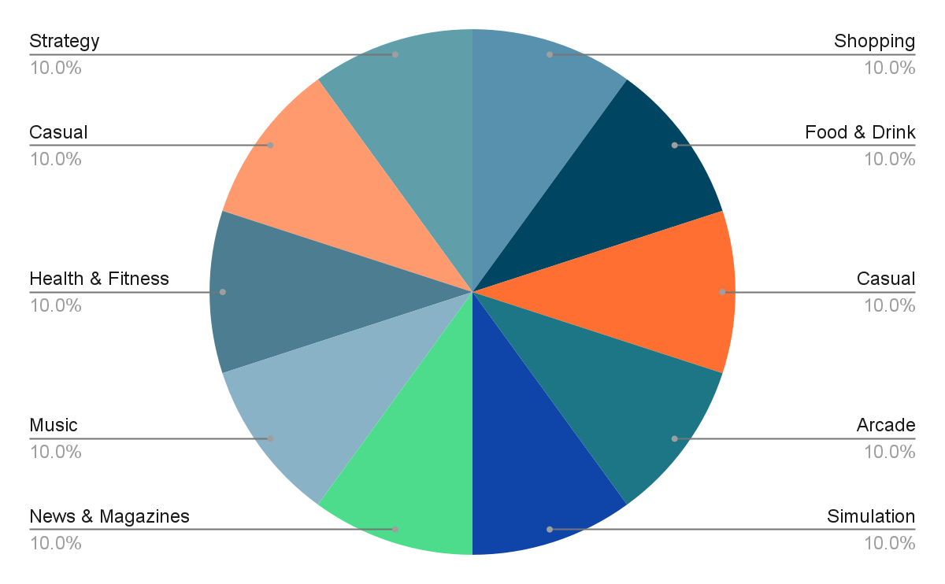
Genre Breakdown
Games represented the majority of our recommended apps-
It is not included in our data set but it is worth mentioning that in-app purchases can be an advantage in the long-term when investing in gaming related applications
Notes:
Slide 6: Sean

Slide 6
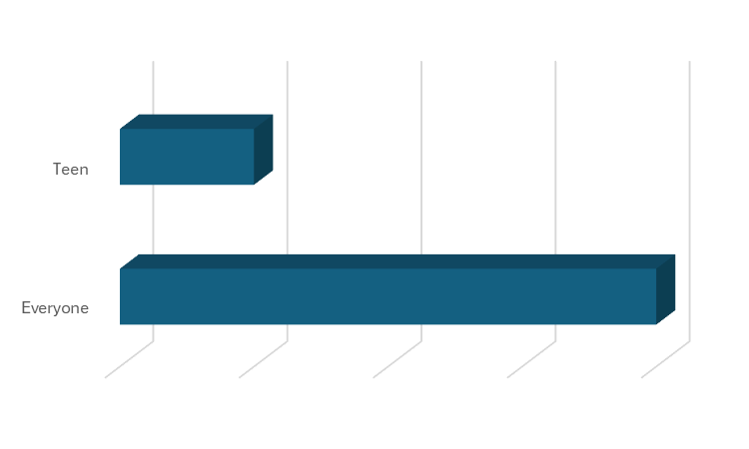
Content Rating Breakdown
• Games rated for Everyone are typically less risky to invest in based on accessibility
•These games are more accessible to families and younger users, reducing content restrictions that could limit reach.
• Restricted apps can be profitable based on popularity and app purchase price
• Popularity among a target demographic can drive high revenue despite accessibility limitations
20%
80%
Notes:
Slide 7: Vlad

Slide 7
Summary
Price range
Target Free or Low-Cost Apps
Balanced Investment
Genre
Casual Games (or “Time Killers”)
Utility & Daily Use Apps
Content rating
“Everyone” Rated Apps Dominate
Other Insights
High Average Ratings Drive Lifespan
Dual-Platform Availability Boosts Revenue
Notes:
Target Free or Low-Cost Apps: The most profitable apps had a purchase price of $10,000 (for free or under $1 apps) while still offering high returns.
Balanced Investment: Apps with a small price (e.g., $1.99 or $6.99) still showed solid profits but with slightly lower total profit margins compared to free apps.
Casual Games (or “Time Killers”): They generate stable revenue through frequent sessions and in-app purchases, with high engagement due to their ease of use
Utility & Daily Use Apps: They maintain a stable income through regular usage and monetization through advertising and in-app purchases, with high user retention rates.
“Everyone” Rated Apps Dominate: 8 out of 10 top apps have an Everyone rating, making them accessible to a broader audience and maximizing potential downloads.
High Average Ratings Drive Lifespan: Apps with an average rating of 4.5 or higher had the longest lifespan (up to 11 years), leading to greater long-term profits.
Dual-Platform Availability Boosts Revenue: Apps on both iOS and Android double their earning potential while maintaining a single marketing cost.

Slide 8
Thank you
Questions?you

